Slide 1


Revolutionising B.Tech.

Slide 2
Python List

Slide 3
List:
A list is a compound data type, you can group values together
A list contains items separated by commas and enclosed within square brackets ([]).
Lists are similar to arrays in C.
One difference between them is that the items belonging to a list can be of different data type.
The values stored in a list can be accessed using the [ ] operator
Index starts at 0.

Slide 4
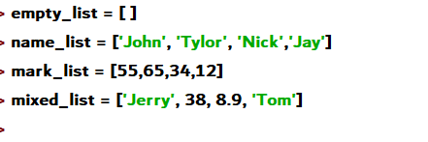
Creating List:

Slide 5
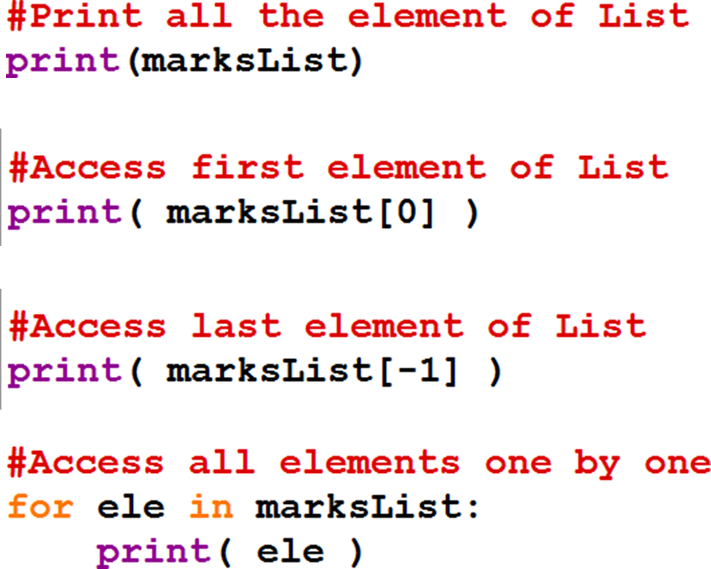
Accessing Elements of List:

Slide 6
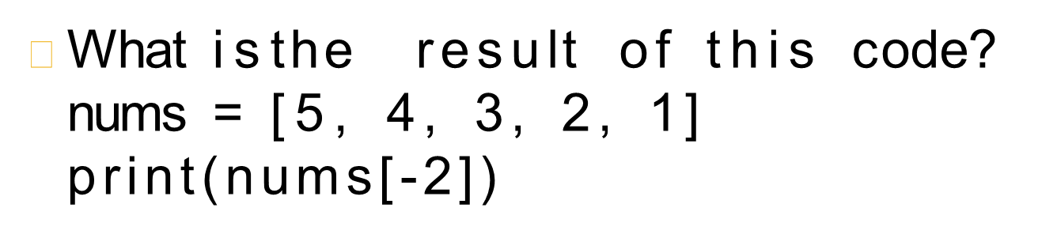
Exercise

Slide 7
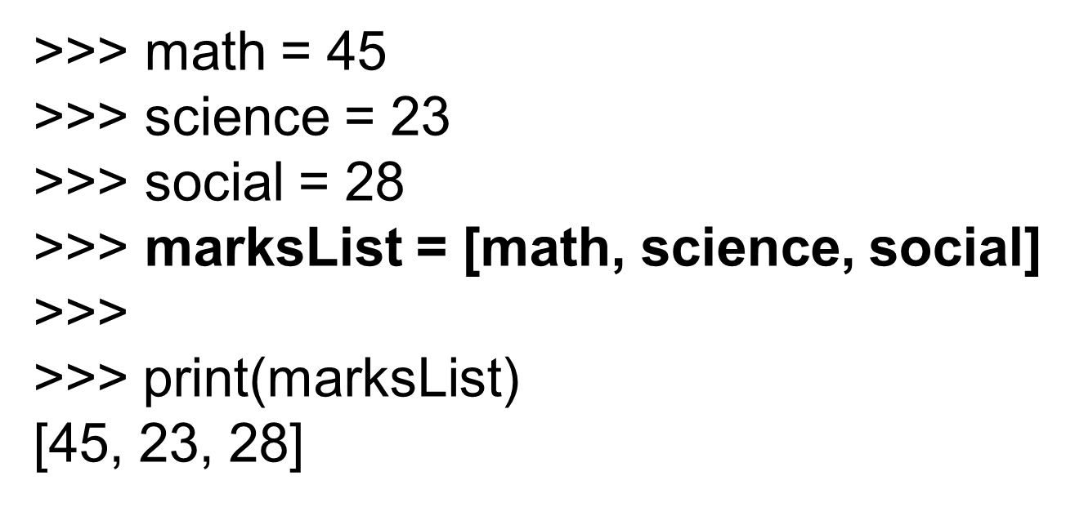
Filling list with variables:

Slide 8
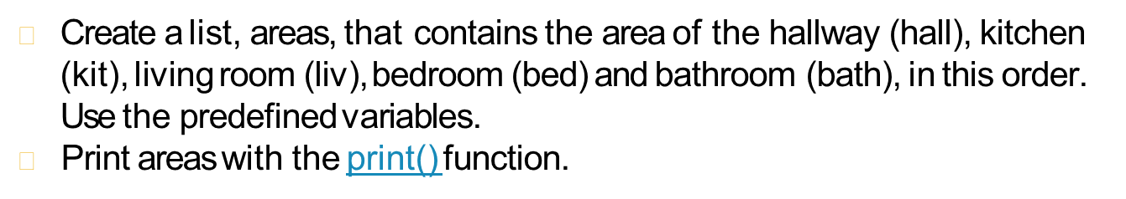
Exercise:
# area variables (in square meters)
hall = 11.25
kit = 18.0
liv = 20.0
bed = 10.75
bath = 9.50
# Create list areas
# Print areas

Slide 9
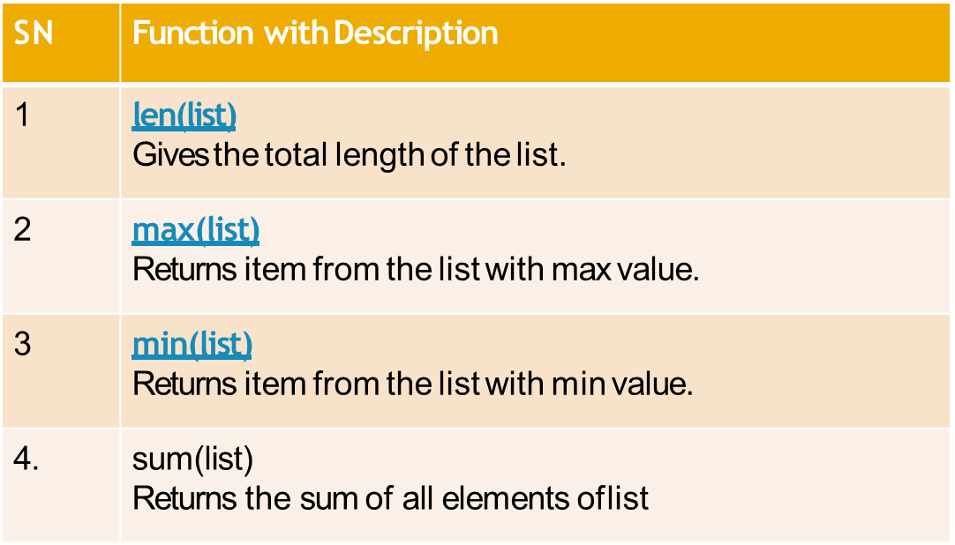
List Functions

Slide 10
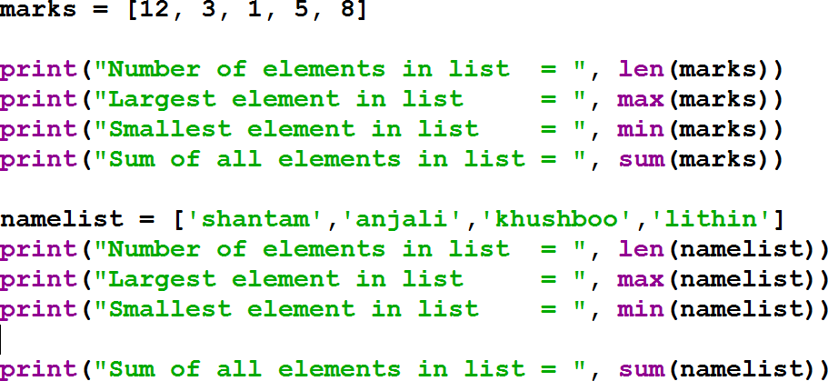
List Functions

Slide 11
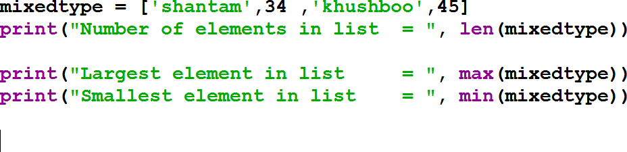
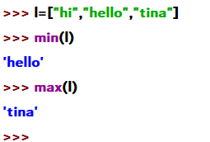
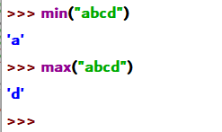
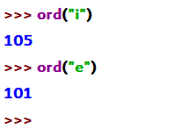
List Functions

Slide 12
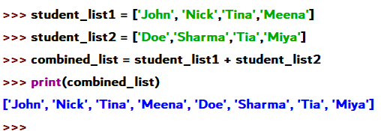
List Concatenation

Slide 13
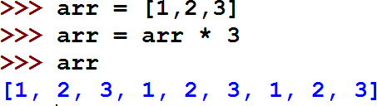

Repeating sequence with * operator:
Forming new lists with a repeating sequence using the multiplication operator:
Create a list of 5 elements with initial value as 0

Slide 14
Built-in List Methods
Insertion | Append(ele) | Add element at end of List
 | Insert(index , ele) | Add element at given index
 | Extend( seq ) | Appends all the elements of seq to list
Deletion | Pop(index) | Delete element based on Index
 | Remove(key) | Delete element based on key
 | Count(key) | Returns the number of occurrences of key
 | Index(key) | Returns the index of key element
 | Sort | Sorts elements of List
 | Reverse | Reverses elements of list

Slide 15
Append: Add elements to list
We can add elements to list.
To add one element, use append method.
This adds an item to the end of an existing list.
mylist = [] mylist.append(5) mylist.append(8) mylist.append(12)
#prints [5,8,12]
print(mylist)

Slide 16
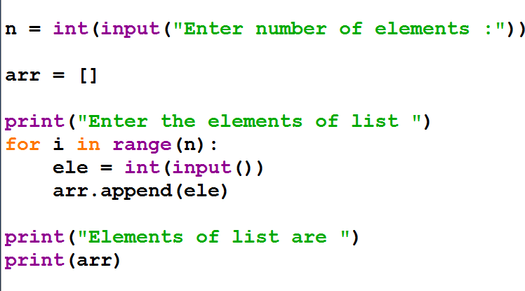
Append: Add elements to list

Slide 17
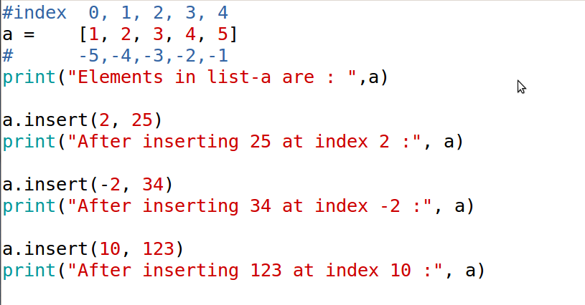
Insert Method:
insert(index, element)

Slide 18
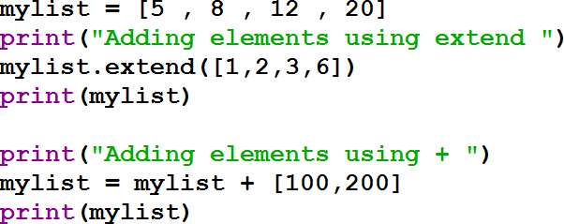
Adding Elements to list: extend
We can add a series of elements using extend method or + operator.

Slide 19
Adding Elements to List: Extend
a = [1,2,3]
b = [4,5,6]
Understand the difference between
a.append(b) and
a.extend(b)

Slide 20
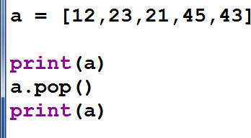
Deleting Elements from List:
To delete last element

Slide 21
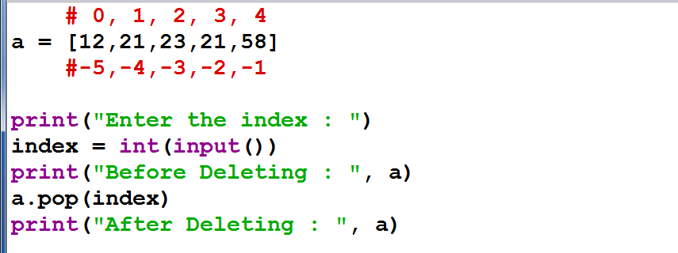
Delete Element from List:
To delete element at specific Index

Slide 22
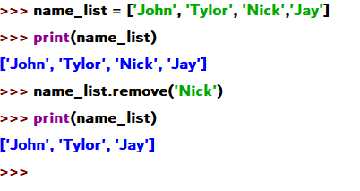
Removing a specific element
Remove method takes the key element to delete and removes it if present.

Slide 23
Index Method:
index() method finds the given element in a list and returns its position.
If the same element is present more than once, index() method returns its smallest/first position.
If not found, it raises
a ValueError exception indicating the element is not in the list.

Slide 24
Index Method:
The index method finds the first occurrence of a list item and returns its index.
If the item isn't in the list, it raises a ValueError.
letters = ['p', 'q', 'r', 's', 'p', 'u']
print(letters.index('r'))
print(letters.index('p'))
print(letters.index('z'))
2
0
ValueError: 'z' is not in list

Slide 25
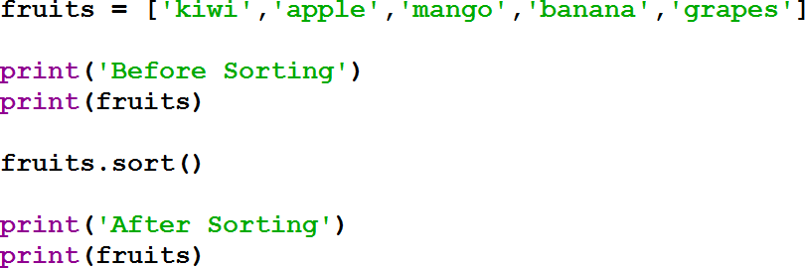
Sorting List:
The sort method can be used to sort the elements of the list.

Slide 26
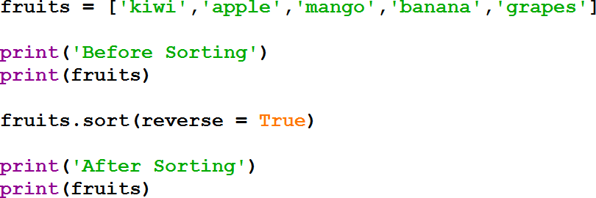
Sorting in Descending Order:

Slide 27
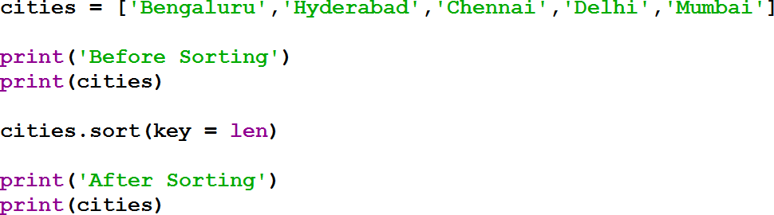
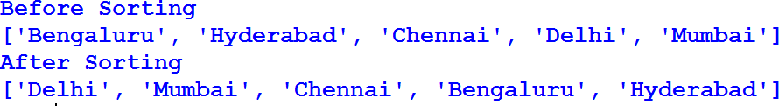
Sorting Based on Length:

Slide 28
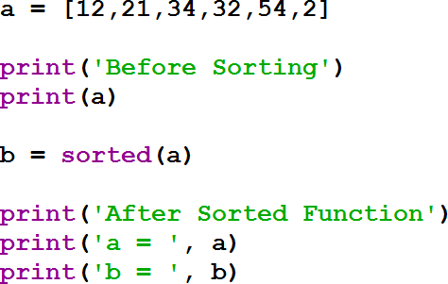
Sorting Based on Length:

Slide 29
List Slicing:
mylist = [5 , 8 , 12 , 20 , 25, 50]
mylist[startIndex : endIndex]

Slide 30
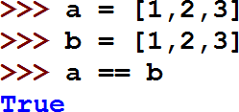
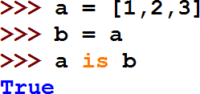
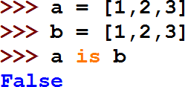
Comparing two list
== operator is used to check if two list have same elements.
is operator is used to check if two references refer to same list.

Slide 31
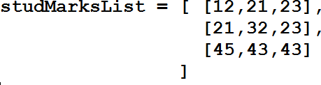
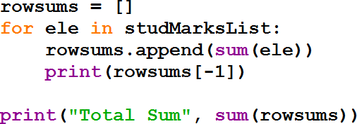
Nested List:

Slide 32
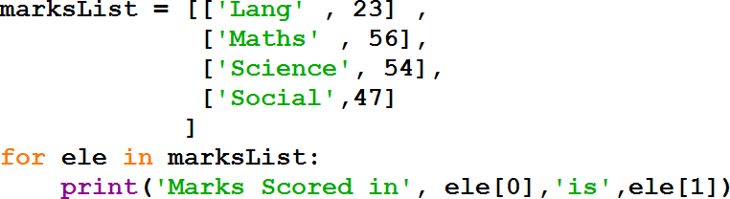
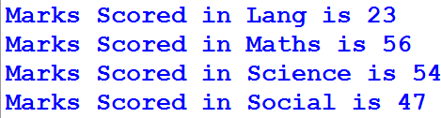
Nested List

Slide 33
Calculating BMI
BMI = weight/height²
height= [ 1.87, 1.87, 1.82, 1.91, 1.90, 1.85]
weight = [81.65, 97.52, 95.25, 92.98, 86.18, 88.45]
bmi = weight / (height ** 2)

Slide 34
Calculating BMI:
BMI = weight/height²
height =[ 1.87, 1.87, 1.82, 1.91, 1.90, 1.85]
weight = [81.65, 97.52, 95.25, 92.98, 86.18, 88.45]
bmi = []
n = len(height)
for i in range(0,n):
bmi.append(weight[i] / (height[i] ** 2))
print (bmi)

Slide 35
Mutability
Mutable is when something is changeable.
It’s the ability of objects to change their values.
Objects of built-in type that are mutable are:
Lists
Sets
Dictionaries
User-Defined Classes (It purely depends upon the user to define the characteristics)

Slide 36
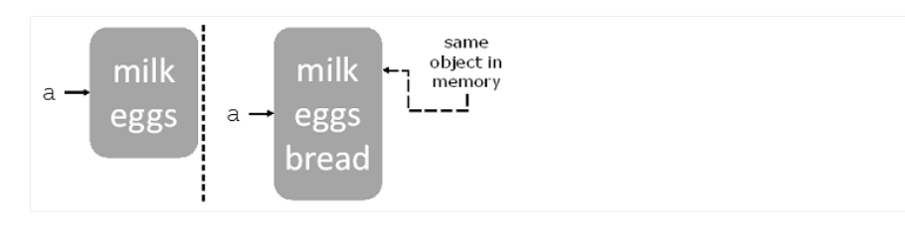
Mutability Examples:
Real time example for mutability is grocery list.
The below figure shows what happens in memory when you bind variables to mutable objects.
When you modify the object, you keep the same variable binding and the object at the same memory location’s directly modified.

Slide 37
References
Python program accesses data values through references
A reference is a name that refers to the specific location in memory of a value (object).
References take the form of variables, attributes, and items.
A reference variable is a variable that points to an object of a given class, letting you access the value of an object.
. Attributes are variables of a class that are shared between all of its instances.

Slide 38
All Function:
The all() function returns True if all elements of the supplied iterable are true or if there are no elements.
So, if all elements in a list, tuple, or set match Python's definition of being true, then all() returns True.

Slide 39
Any Function:
The any() function is the converse of the all() function. any() returns True if any element of the iterable evaluates true.
If the iterable is empty, the function returns False.

Slide 40
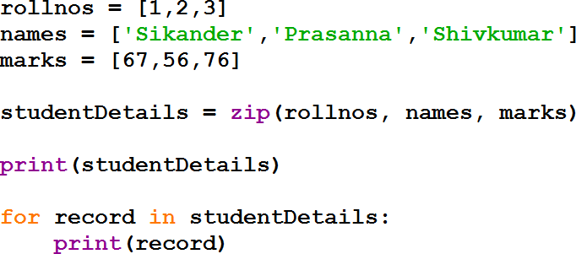

Zip Function
The zip() function take iterables, makes iterator that aggregates elements based on the iterables passed, and returns an iterator of tuples.

Slide 41
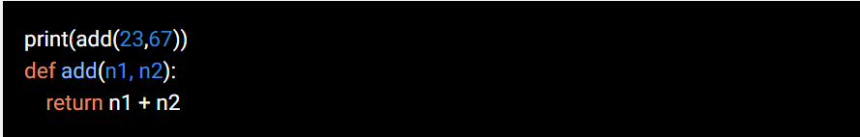
Common errors:
Wrong Function Definition and Function Call Order
Example:
Calling the function even before you define your function. The function definition runs first and creates the function in python programming before you can call it. If you call the function earlier than python will throw an error.

Slide 42
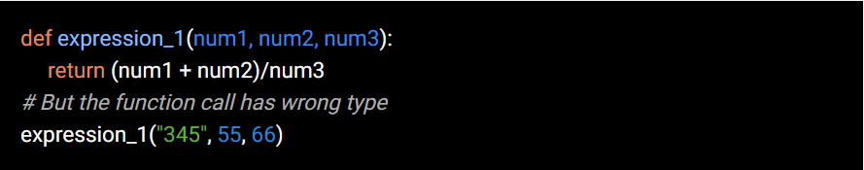
Common errors:
Parameter Mismatch Error
Example:
when you call the function with either wrong parameter type or less number of parameters, python will throw an error in each case.

Slide 43
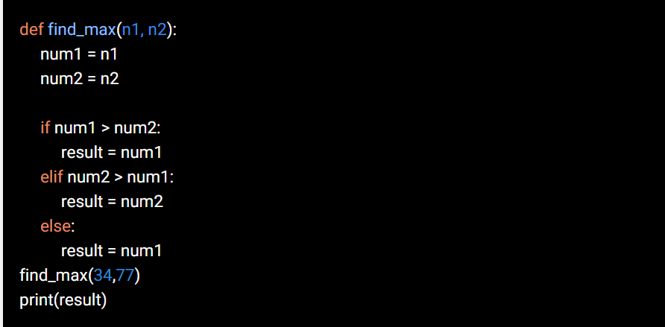
Common errors:
Scope Error
Example:
This is possible in the case of a conditional block such as if, if-then-else, etc. This is called a scope error..

Slide 44
Python Tuples

Slide 45
Python Tuples
Tuples are very similar to lists, except that they are immutable (they cannot be changed). They are created using parentheses, rather than square brackets.

Slide 46
Python Tuples
We generally use tuple for heterogeneous (different) datatypes and list for homogeneous (similar) datatypes.
Since tuple are immutable, iterating through tuple is faster than with list. So there is a slight performance boost.
Tuples that contain immutable elements can be used as key for a dictionary. With list, this is not possible.
If you have data that doesn't change, implementing it as tuple will guarantee that it remains write-protected.
3

Slide 47
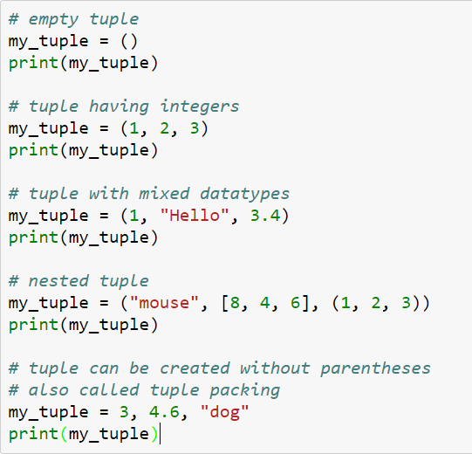
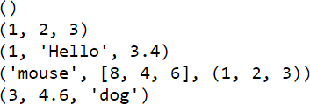
Creating a Tuple
A tuple is created by placing all the items (elements) inside a parentheses (), separated by comma.
The parentheses are optional but is a good practice to write it.
A tuple can have any number of items and they may be of different types (integer, float, list, string etc.).
3

Slide 48
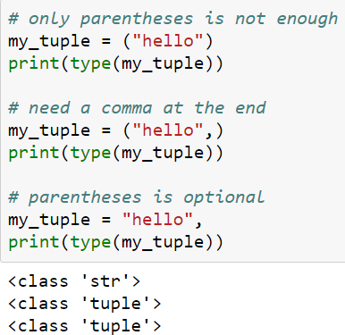
Creating a Tuple
Creating a tuple with one element is a bit tricky.
Having one element within parentheses is not enough.
We will need a trailing comma to indicate that it is in fact a tuple.

Slide 49
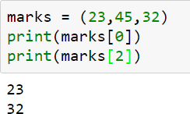
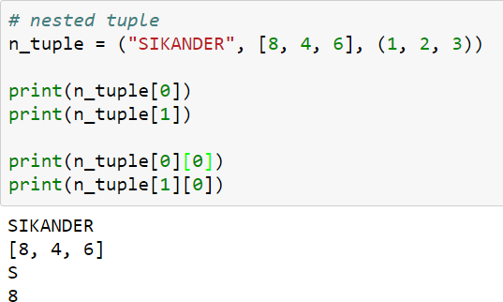
Accessing Elements in a Tuple
You can access the values in the tuple with their index, just as you did with lists:
Nested tuple are accessed using nested indexing
Negative indexing can be applied to tuples similar to lists.
We can access a range of items in a tuple by using the slicing operator
Trying to reassign a value in a tuple causes a TypeError.

Slide 50
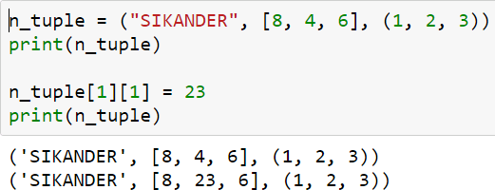
Changing a Tuple
Unlike lists, tuples are immutable.
This means that elements of a tuple cannot be changed once it has been assigned. But, if the element is itself a mutable datatype like list, its nested items can be changed.

Slide 51
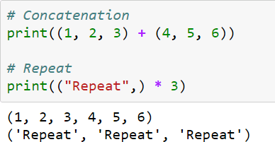
Changing a Tuple
Similar to List,
We can use + operator to combine two tuples. This is also called concatenation.
We can also repeat the elements in a tuple for a given number of times using the * operator.
Both + and * operations result into a new tuple.

Slide 52
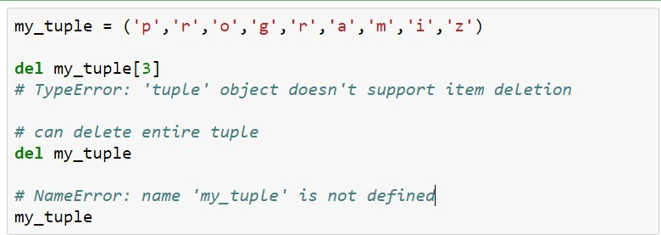
Deleting a Tuple
We cannot change the elements in a tuple. That also means we cannot delete or remove items from a tuple.
But deleting a tuple entirely is possible using the keyword del.

Slide 53
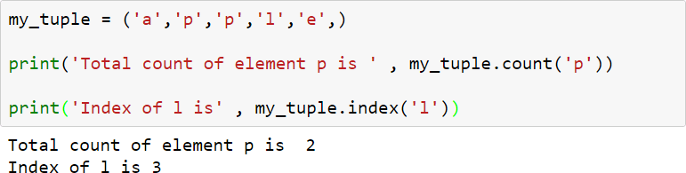
Python Tuple Methods
Methods that add items or remove items are not available with tuple.
Only the following two methods are available.
Method | Description
count(x) | Return the number of items that is equal to x
index(x) | Return index of first item that is equal to x

Slide 54
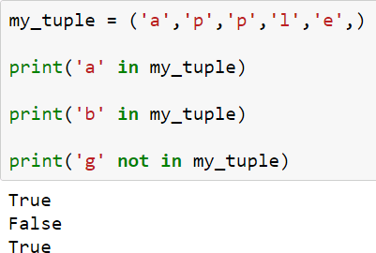
Tuple Membership Test
We can test if an item exists in a tuple or not, using the keyword in.

Slide 55
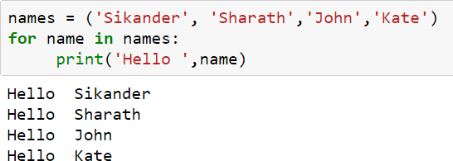
Iterating Through a Tuple
Using a for loop we can iterate though each item in a tuple.

Slide 56
Built-in Functions with Tuple
Function | Description
all() | Return True if all elements of the tuple are true (or if the tuple is empty).
any() | Return True if any element of the tuple is true. If the tuple is empty, return False.
enumerate() | Return an enumerate object. It contains the index and value of all the items of tuple as pairs.
len() | Return the length (the number of items) in the tuple.
max() | Return the largest item in the tuple.
min() | Return the smallest item in the tuple
sorted() | Take elements in the tuple and return a new sorted list (does not sort the tuple itself).
sum() | Retrun the sum of all elements in the tuple.
tuple() | Convert an iterable (list, string, set, dictionary) to a tuple.

Slide 57
Python Sets

Slide 58

Sets Definition:
Sets are used to store multiple items in a single variable.
Set is one of 4 built-in data types in Python used to store collections of data, the other 3 are List, Tuple, and Dictionary.
Syntax of set:
where <iter> : iterable can be anything like list, tuple,etc. List and tuple are the other built-in data structures in python just like settings.

Slide 59
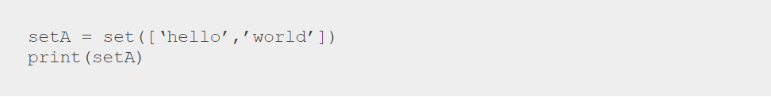
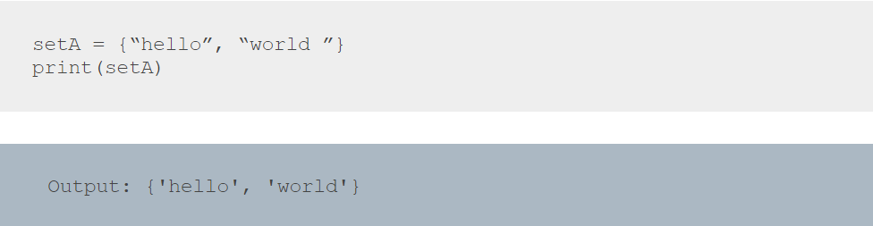
Example:
The other way to create a set in python is to define the elements in a set of curly braces: The syntax for the same is shown as follows:

Slide 60
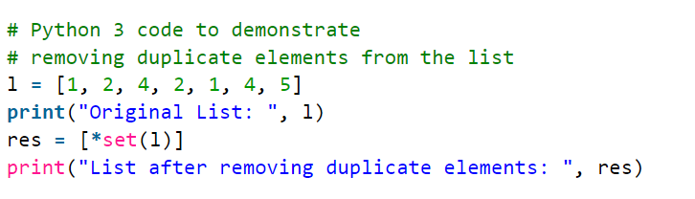

Exercise
Given a list of elements, remove the duplicate elements.

Slide 61

Exercise
Read a string and find the number of unique characters in it.

Slide 62

Exercise

Slide 63




Sets
Sets can be used to carry out mathematical set operations like union, intersection, difference and symmetric difference.
We can do this with operators or methods.
Method | Operator
union | |
intersection | &
difference | -
symmetric_difference | ^

Slide 64


Example

Slide 65
Operators
key in s | containment check
key not in s | non-containment check
s1 == s2 | s1 is equivalent to s2
s1 != s2 | s1 is not equivalent to s2
s1 <= s2 | s1 is subset of s2
s1 < s2 | s1 is proper subset of s2
s1 >= s2 | s1 is superset of s2
s1 > s2 | s1 is proper superset of s2
s1 | s2 | the union of s1 and s2
s1 & s2 | the intersection of s1 and s2

Slide 66


Example

Slide 67


Example

Slide 68

Example

Slide 69
Set Mutation Operations
We have seen the applications of union, intersection, difference and symmetric difference operations, but these operations do not make any changes or mutations to the set.
We can use the following operations to create mutations to a set:
Method | Operator
update | |= | Update the set by adding elements from an iterable/another set.
intersection_update | &= | Update the set by keeping only the elements found in it and an iterable/another set.
Difference_update | -= | Update the set by removing elements found in an iterable/another set.
symmetric_difference_update | ^= | Update the set by only keeping the elements found in either set, but not in both.

Slide 70
Set Mutation Operations
Isdisjoint– This method will return True if two set have a null intersection
Issubset – This method reports whether another set contains this set
Issuperset – This method will report whether this set contains another set

Slide 71

Set Mutation Operations

Slide 72
Python Dictionary

Slide 73
Python Dictionary:
In Python, a dictionary is a set of keys and values that can be used to store data values like a map, in contrast to other data types that can only contain a single value per element.

Slide 74
More on Dictionary:
An unordered collection of elements is a Python dictionary.
In contrast to other compound data types, dictionaries include a key:value pair.
When the key is known, dictionaries are designed to retrieve values quickly.

Slide 75
Creating a Dictionary:
By putting a series of components within curly brackets and separating them with a comma, one can create a dictionary in Python.
Dictionary has two equivalent pair elements, one of which is the Key and the other is its Key:value.
A dictionary's values can be of any data type and can be replicated, but its keys must be immutable and cannot be repeated.
Note – Dictionary keys are case sensitive, the same name but different cases of Key will be treated distinctly.

Slide 76
Example:
marks = {“Maths” : 34, “Science” : 22 ,”English” :56}
print(marks)
xyz = {“Name” : ‘Tina’, 1:[2,4,1,7]}
print(xyz)
Dictionary = { }
print(“Empty Dictionary”,Dictionary)

Slide 77
Inbuilt dict() function:
Dict = dict({1: ‘Apple', 2: ‘Andriod', 3: ‘Tablet'})
print("\nDictionary with the use of dict(): ")
print(Dict)
# Creating a Dictionary
# with each item as a Pair
Dict = dict([(1, ‘Lamborgini'), (2, ‘BMW')])
print("\nDictionary with each item as a pair: ")
print(Dict)

Slide 78
Nested Dictionary:
# Creating a Nested Dictionary
DT = {1: 'Jain', 2: 'University',
3: {'A': 'Welcome', 'B': 'To', 'C': 'SET'}}
print(DT)

Slide 79
Adding element(s) to a Dictionary:
Multiple methods can be used to add items.
By defining the value and the key together, for example, Dict[Key] = "Value," one value can be added to a dictionary at a time.
Using the built-in update() method, one can modify an existing value in a Dictionary.
An existing Dictionary may also be expanded with nested key values.
Note: When adding a value, the value is updated if the key-value combination already exists. If not, a new key and value are added to the dictionary.

Slide 80
Example:
# Adding elements one at a time
Dict[0] = 'Jain'
Dict[2] = 'University'
Dict[3] = 10
print("\nDictionary after adding 3 elements: ")
print(Dict)

Slide 81
Example:
# Adding set of values to a single Key
Dict['Value_set'] = 24, 3, 43
print("\nDictionary after adding 3 elements: ")
print(Dict)

Slide 82
Example:
# Adding Nested Key value to Dictionary
Dict[5] = {'Nested': {'1': 'Deemed', '2': 'To be University'}}
print("\nAdding a Nested Key: ")
print(Dict)

Slide 83

Solution:

Slide 84
Accessing element of a Dictionary:

Slide 85

Solution:

Slide 86


Accessing an element of a nested dictionary

Slide 87
Dictionary Methods:
clear() | Remove all the elements from the dictionary
copy() | Returns a copy of the dictionary
get() | Returns the value of specified key
items() | Returns a list containing a tuple for each key value pair
keys() | Returns a list containing dictionary’s keys
pop() | Remove the element with specified key

Slide 88
Dictionary Methods:
popitem() | Removes the last inserted key-value pair
update() | Updates dictionary with specified key-value pairs
values() | Returns a list of all the values of dictionary

Slide 89

Examples for all Dictionary Methods

Slide 90

Examples for all Dictionary Methods

Slide 91
Python Functions

Slide 92
Function Definition:
It is not advised to write a collection of statements separately if they are needed repeatedly.
These statements must be defined as one unit, which we can then call as many times as necessary to meet our requirements without having to rewrite anything.
Function alone defines this apparatus.

Slide 93
Function Definition:
The main advantage of functions is code Reusability.
Note: In other languages, functions are known as methods, procedures, subroutines, etc.
Python supports 2 types of functions
Built In Functions
User DefinedFunctions

Slide 94
Built In Functions:
Built-in or predefined functions refer to the functions that are automatically included with Python software.
id()
type()
input()
eval()

Slide 95
User defined functions:
User defined functions are those that are explicitly developed by programmers in accordance with business requirements.
Syntax:
def function_name(parameters):
statements
return value
Keywords

Slide 96

Function Call
Once we have defined a function, we can call it from another function, program or even the Python prompt.
To call a function we simply type the function name with appropriate parameters.
Calling the Function my_function()

Slide 97

Example: WA Function to print “BE YOU,DO YOU ,FOR YOU

Slide 98

Parameters:
The function's inputs are the parameters.
If a function has parameters, we must provide values at the time of calling; otherwise, we will receive an error.

Slide 99

Write a function to get square of user input number:

Slide 100

Return Statement:
Function can take input values as parameters and execute the logic, and return the output to the caller with return statement.

Slide 101

Return Statement:
If we are not mentioning return statement, then default return value is None.

Slide 102

Exercise: WA function to find whether the given number is even or odd:

Slide 103

Function returning multiple value

Slide 104
Scope and Lifetime of variables
Scope of a variable is the portion of a program where the variable is recognized.
Parameters and variables defined inside a function is not visible from outside. Hence, they have a local scope.
Lifetime of a variable is the period throughout which the variable exits in the memory.The lifetime of variables inside a function is as long as the function executes.
They are destroyed once we return from the function. Hence, a function does not remember the value of a variable from its previous calls.

Slide 105




Scope and Lifetime of variables

Slide 106

Scope and Lifetime of variables

Slide 107

Scope and Lifetime of variables

Slide 108
Types of Arguments
There are 4 types are actual arguments are allowed In Python.
Positional Arguments
Keyword Arguments
Default Arguments
Variable length Arguments

Slide 109
Positional Arguments:
These are the arguments passed to function in correct positional order.
The number of arguments and position of arguments must be matched. If we change the order then result may be changed and if number of arguments differ, then we will get error.

Slide 110

Positional Arguments:

Slide 111
Keyword Arguments:
We can pass argument values by keyword i.e, by parameter name.
Here the order of arguments is not important but number of arguments must be matched.
Note; We can use both positional and keyword arguments at the same time. But first we have to take positional arguments and then keyword arguments, else we will get syntaxerror.

Slide 112


Keyword Arguments

Slide 113

Keyword Arguments

Slide 114

Keyword Arguments

Slide 115

Default Arguments
Function arguments can have default values in Python.
We can provide a default value to an argument by using the assignment operator (=).

Slide 116
Default Arguments:
In this function, the parameter amount does not have a default value and is required (mandatory) during a call.
On the other hand, the parameter discountPercentage has a default value of 0. So, it is optional during a call.
If a value is provided, it will overwrite the default value.
Any number of arguments in a function can have a default value.

Slide 117
Default Arguments
Once we have a default argument, all the arguments to its right must also have default values.
SyntaxError: non-default argument follows default argument

Slide 118
Variable Length Arguments:
Variable length arguments are those that we can occasionally supply to our function in a variable number.
The following symbol can be used to declare an argument of variable length: def func(*n):
Any number of parameters, even zero, may be sent to this function when calling it, and all of the values are internally represented as tuples.

Slide 119




Variable number of arguments

Slide 120

Functions as Objects
Although functions are created differently from normal variables, functions are just like any other kind of value.
They can be assigned and reassigned to variables, and later referenced by those names.

Slide 121




Functions as Objects

Slide 122

Recursive Functions:
A function that calls itself is known as Recursive Function.
Advantages of recursive functions are:
We can reduce length of the code and improves readability.
We can solve complex problems very easily.

Slide 123

Recursive Functions:

Slide 124

Recursive Algorithms:
A recursive algorithm is an algorithm which calls itself with a smaller problem.
If a problem can be solved utilizing solutions to smaller versions of the same problem and the smaller versions reduce to easily solvable cases, then one can use a recursive algorithm to solve that problem.
They are of two types: indirect and direct recursion
Example :Code for determining if a given list contains a given string

Slide 125



Search using recursive Algorithms:

Slide 126

Recursive explorations of all possibility :
This is supposed to return a list back to the use with all the possible permutations.
Example :Code to return all possible permutation of string.

Slide 127
Anonymous Function:
When a function is declared, it may not have a name.
These types of nameless functions are known as anonymous functions or lambda functions.
The anonymous function's primary use is only for one-time, instantaneous use.

Slide 128
Lambda Function:
Lambda keyword lambda n:n•n allows us to define.
Lambda syntax
Expression: lambda argument list: function
Note: By using lambda functions, we may create extremely brief code, improving the readability of the program.

Slide 129

Lambda Function:
Write a Program to create a Lambda Function to find Square of given Number?

Slide 130


Sum of numbers using lambda:
Find largest of numbers using lambda:

Slide 131
Note
We are not required to write an explicit return statement because Lambda Functions return expression values internally.
It should be noted that functions can occasionally be passed as arguments to other functions.
The best option in these situations is lambda functions.
Due to the fact that filter(), map(), and reduce() expect a function as an argument, lambda functions are frequently used with these functions.

Slide 132
filter() Function:
filter() function is used to filter values from the given sequence based on some condition.
filter(function(sequence))
Where Function Argument is responsible to perform conditional check Sequence can be List OR Tuple OR String.

Slide 133

filter() Function:

Slide 134

Using lambda and filter():

Slide 135
map() function:
Python’s map() function takes in a list and another function.
The function argument is called with all elements in the list and returns a new list containing elements returned from each element in the original list.
Syntax: map(function,sequence)

Slide 136

map() function:

Slide 137

With lambda and map():

Slide 138
reduce() function:
reduce() function reduces the sequence of elements Into a single element by applying the specified function.
Syntax: reduce(function, sequence)
reduce() function is present in functools module and hence we should write import statement.

Slide 139


Slide 140

eval() function:
This will allows you to evaluate arbitrary Python expressions from a string-based or compiled-code-based.
This function can be handy when you're trying to dynamically evaluate Python expressions from any input that comes as a string or a compiled code object.
Syntax of eval()

Slide 141


Slide 142

zip() function:
zip() function returns a zip object.
This is an iterator of tuples where the first item in each passed iterator is paired together, and then the second item in each passed iterator are paired together etc.
Syntax of zip()

Slide 143


Example:

Slide 144

Cartesian Product:
Suppose we have 2 list of data list1 and list2.
To find the cartesian product of (a,b) and (c,d) = {(a,c),(a,d),(b,c),(b,d)}
To find this , we will use the itertools library and product function which is present in this library.

Slide 145
exec() function:
The exec() function is used to execute Python program dynamically.
These program can either be strings or object code.
If it's a string, it's translated into a series of Python statements that are then performed, barring any syntax errors; if it's object code, it's just executed.
Using return statements outside of function declarations, not even in the context of code provided to the exec() method, requires caution.
It returns None since it has no value to return.

Slide 146

exec() function:

Slide 147

copy() function:
The copy() method returns a copy of the list.

Slide 148
enumerate():
Returns an enumerate object which contains the value and index of all list elements as tuple.
Returns an enumerate object which contains the value and index of all set elements as a pair.
Returns an enumerate object containing the value and index of all tuple elements as pairs.

Slide 149

enumerate():

Slide 150
List Comprehensions:
It is very easy and compact way of creating list objects from any lterableobjects (like list,Tuple, Dictionary, Range.etc) based on some condition.
Syntax:
list=[expression for elements in list if conditions]

Slide 151


List Comprehensions:

Slide 152
LIST Vs TUPLE Vs SETS:
List | Tuple | Set
Lists is Mutable | Tuple is Immutable | Set is Mutable
It is Ordered collection of items | It is Ordered collection of items | It is Unordered collection of items
Items in list can be replaced or changed | Items in tuple cannot be changed or replaced | Items in set cannot be changed or replaced

Slide 153
Mutable:
When anything can be altered or changed, it is said to be mutable. The term "mutable" in Python refers to an object's capacity to modify its values. These are frequently the things that hold a data collection.
Immutable: Immutable refers to a state in which no change can occur over time. An object is referred to as immutable in Python if its value cannot change over time. The worth of these things is fixed once they are made.

Slide 154

Adding output comment for debugging:
The logging module has everything.
Its recommend using logging.basicConfig to toggle the logging level to stderr and the simple log methods, debug, info, warning, error and critical.
Code sample below is used for logging:

Slide 155
Thank You!

